Slide 1
UNCLASSIFIED CUI
Individual Development Plan Training
Presented by
AFDW/A1KF
Human Resources Development Specialist
UNCLASSIFIED CUI
Notes:
*****AFTER ATTENDEE CHECK-IN IS COMPLETE START WITH…..
Good afternoon Everyone and welcome to todays Directors Meeting.

Slide 2
OVERVIEW
IDP Mandates
Management and Planning
IDP Process
IDP Sections
The goal is to provide instructions for completing the Individual Development Plan process by 27 May each year.

Slide 3
IDP Mandates & Guidance
Authorities and IDP Elements
DoDI 1400.25, Vol 410,
DOD Civilian Personnel Management System: Training, Education, and Professional Development
5 CFR 412.401
AFMAN 36-606, Civilian Career Field Management and Force Development
DAFI 36-2670, Total
Force Development
*OPM.GOV, Training and Development Policy Wiki

Slide 4
Individual Development Planning
Individual development planning helps identify an employee’s career development goals
Planning also involves identifying which strategies to achieve those goals
Supervisor and employee cooperatively complete or update an IDP on an annual basis
*OPM.GOV, Training and Development Policy Wiki

Slide 5
IDP Management & Planning
IDPs must include all training and development classes and programs. Furthermore, all training should be linked to program requirements in the IDP.
Opportunities may be both formal and informal. Formal training should be documented in the Defense Civilian Personnel Data System or other approved tool.
Employees and supervisors are responsible for updating and tracking IDP progress. Supervisor provides a copy of the IDP to employee and maintains a copy in the supervisor’s record.

Slide 6
Advantages
Encourages the employee to take ownership of his/her career development
Provides an administrative mechanism for identifying and tracking immediate and long-term development needs and plans
Documents an action plan to develop specific competencies (knowledge and skills) needed to improve performance in present position or for future responsibilities

Slide 7
IDP PROCESS
IDP Process Flow
Green (CVA); Blue (BVA); Black (Start/Stop)
Pre-Planning Employee & Supervisor Meeting
Prepare IDP
Implement Plan
Evaluate Outcomes
Update IDP to Keep Valid

Slide 8
IDP SECTIONS
Sections A – E—Instructions and Practicum
SECTION A—
EMPLOYEE PERSONAL PROFILE
SECTION E—
SUPERVISOR APPROVAL/CONC URRENCE
SECTION C— CAREER GOALS
SECTION B—
CAREER DEVELOPMENT PLAN
SECTION D—
AIR FORCE INSTITUTIONAL COMPETENCIES
Phases 1-3—Preparation

Slide 9
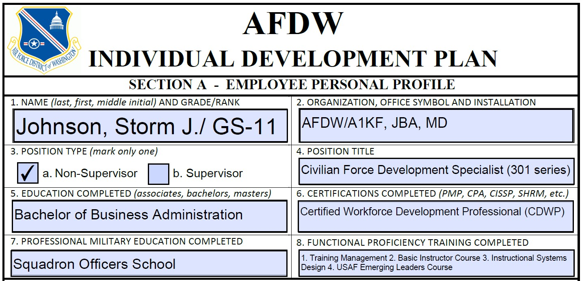
SECTION A (Phases 1-3—Preparation)
Functional Proficiency Training Completed - Enter all technical or functional training completed (e.g., BIC, PFMC, and MCADRE002)
Certifications Completed - Enter professional certifications obtained. Do not enter certifications you are currently working on (e.g., CPA, CISM, PMP, MCSE, SHRM, CISSP).

Slide 10
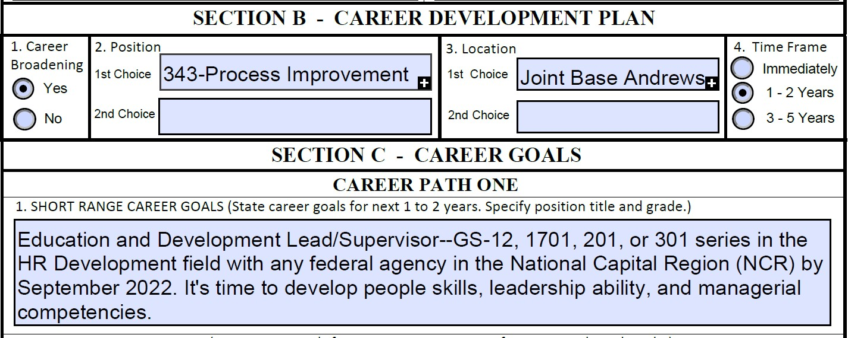
SECTION B
Special assignments, extra duties, special duties, deployment through the Civilian Expeditionary Program, participation on a special project, and community involvement are also options for gaining
a larger breath of experience with relevant
Career development provides an employee opportunities to obtain experiences that would not regularly be available in a single position. Examples of career development include, but are not limited to, centrally funded career broadening, CSLP, and KCPs. Career development does not always require geographic mobility, but it may be necessary.
skills and abilities.

Slide 11
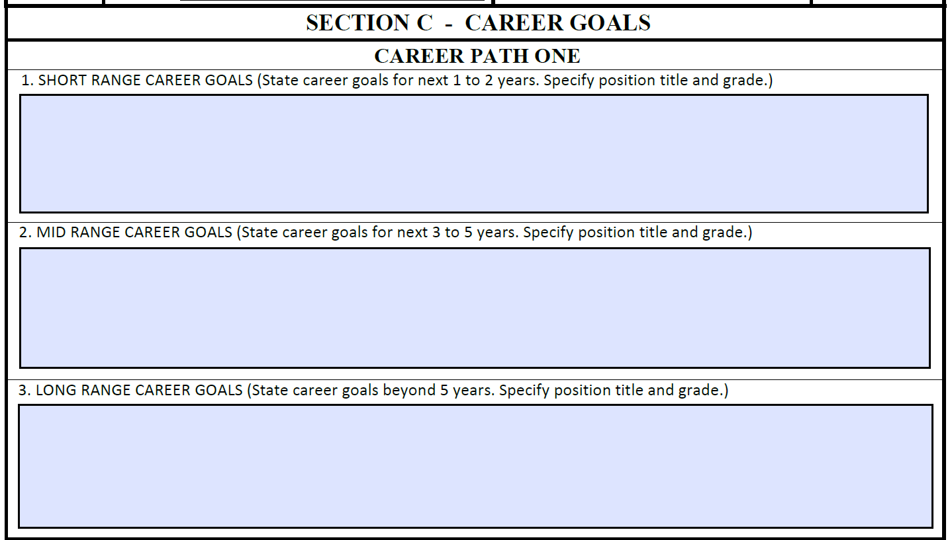
SECTION C – Career Goals
Employee development is a deliberate series of challenging experiences combined with education and training opportunities. Employees should create goals designed to develop tactical, operational, or strategic competencies applicable to their current and desired future positions.
When preparing IDPs, employees should view their career paths through the lens of the AF Individual Development Continuum to identify areas of improvement. The continuum guides employees toward development programs linked to institutional competencies appropriate to each position.
Go ahead…I dare you to dream big here! Set a goal that thrills you and scares you at the same time.

Slide 12
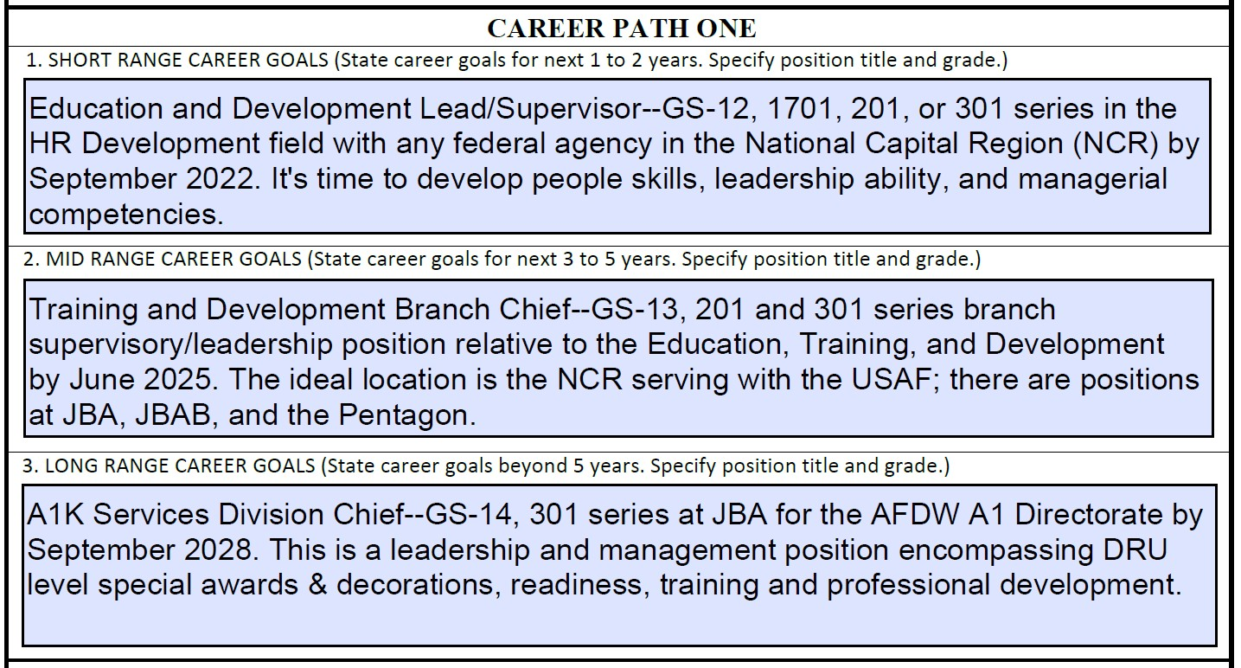
SECTION C – Career Goals
Please note that these are SMART goals. One could also suggest strategies or planned approaches for reaching each goal in each section as well. This will help later as you devise your action plan this year of development.

Slide 13
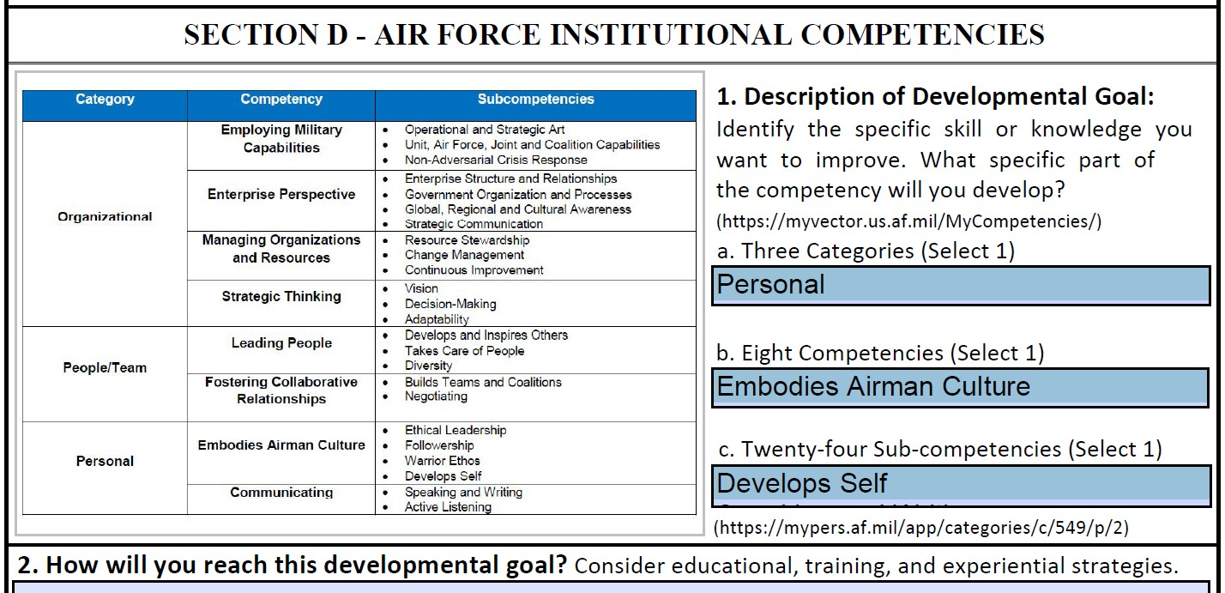
SECTION D
Ensure you relate category to competency and then finally to the specific sub-competency.
These blocks permit you to select from the various options.
State here what strategy for development you will use, educational, training, or experience. Or you may need a combination of these. Consider the areas your assessment identified in MyVector as requirements and the suggested articles, videos, and books to develop these areas. Identify ¹w³ hat steps will be taken and when each item will be completed.

Slide 14
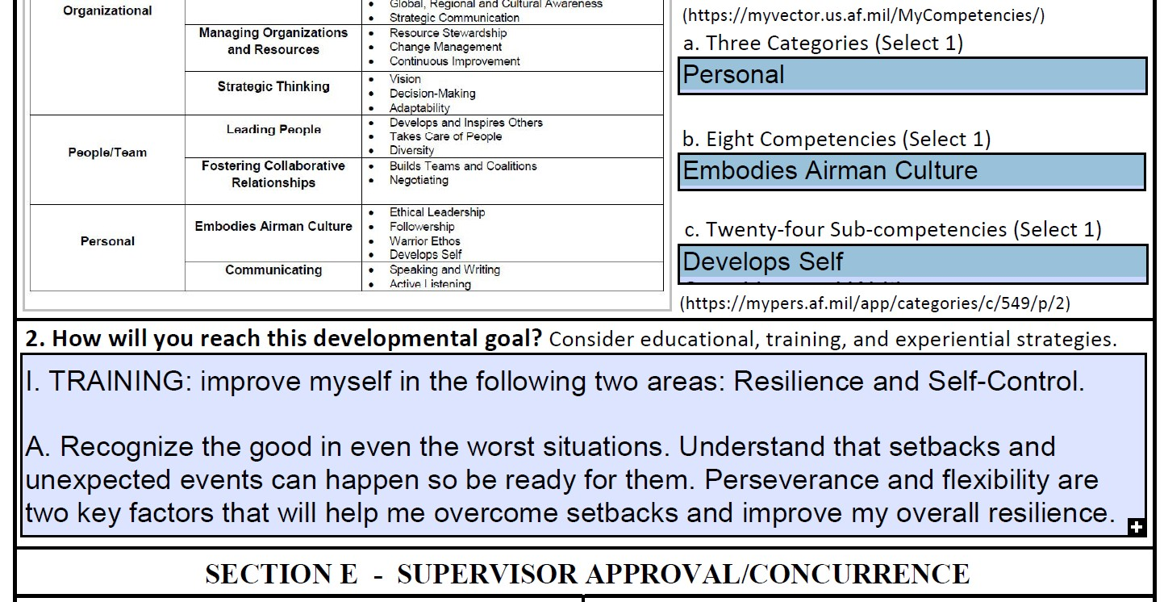
SECTION D, Part 2
Strategizing and planning begins here.
Try to use the SMART Standard to develop your plan of action. Think about your 1 – 2 year goals and consider the results of your MyVector Assessment and the guidance from the Pathfinder¹.⁴These

Slide 15
Section D, Part 2
Section D.2—Practice with IDP training aid
TRAINING: improve in the following two areas: Resilience and Self-Control.
Principles—(1) Recognize the good in even the worst situations. (2) Understand that setbacks and unexpected events can happen so be ready for them. (3) Perseverance and flexibility are two key factors that will help me overcome setbacks and improve my overall resilience.
Complete the following training in AF e-Learning and MyVector:
Read article, “How to Increase Your Resilience as a Leader” by the end of May 2022
Read article, “Cognitive reframing – it’s not about what happens to you, but how you frame it,” by the end of July 2022
Watch video, “The Best Gift I Ever Survived,” by the end of August 2022
Read the book, “Stronger: Develop the Resilience You Need to Succeed,” complete book and develop a plan of action based on the book by December 2022

Slide 16
Section D, Part 2
Section D.2—Practice with IDP training aid
EXPERIENCE:
It is not enough to read these resources alone. I will practice applying the information to my daily life (June 22 – Feb 23). I think it will be helpful to:
Engage a family member, friend, or co-worker to help me practice the techniques I have learn.
Keep a weekly journal of my progress.
III. EVALUATION:
Ask for feedback from others to assess my behavioral changes. Do they perceive me to be improving? If not, continue seeking out training and developmental opportunities that will give me the chance to practice.
Retake the MyVector Assessment (AF Competencies) in February 2023 to verify real improvements.
IV. PROFESSIONAL DEVELOPMENT:
Complete the AF “Organizational Leader Course” through the Civilian Developmental Education (CDE) Short courses (if selected) to prepare for leadership and supervisory positions by August 2023.

Slide 17
SECTION D - Refine the Action Plan
1. Adequate: Does it accomplish the goal?
2. Feasible:
Does it use only the resources apportioned or allowed?
3. Acceptable: Is it worth the possible cost, time, and energy?
4.Distinguishable: Is it meaningfully different in results and outcomes?
Is the impact significant?
5. Complete: Does it answer who, what, when, where, and how?
Feasibility Assessment

Slide 18
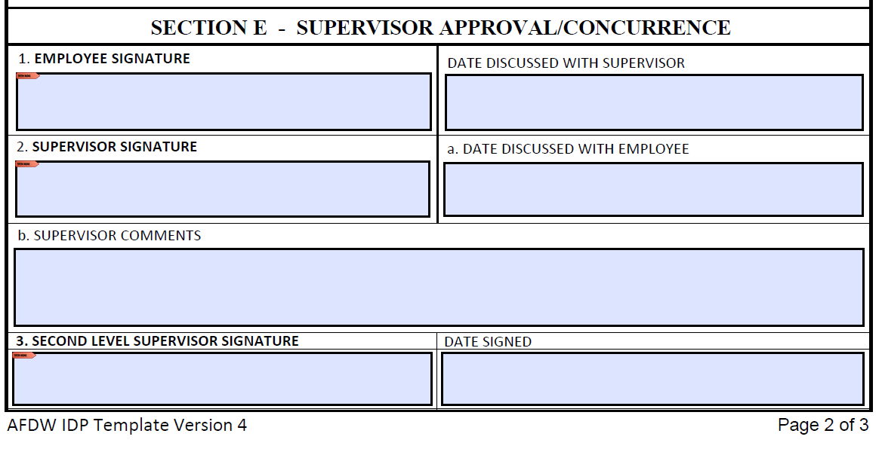
SECTION E
Employee signs indicating the IDP conversation did indeed happen.
Immediate supervisor signs to indicate approval of the IDP proposal and enters any helpful guiding counsel for the employee.
The second level supervisor signs to indicate concurrence and organizational support. He/She may also consider all training requirements collectively in their AOR to possibly identify group training initiatives.

Slide 19
REVIEW
INDIVIDUAL DEVELOPMENT PLANNING
IDP Mandates
Management and Planning
IDP Process
IDP Sections

Slide 20
RESOURCES AND TOOLS
AFDW University: https://www.afdw.af.mil/About-AFDW/AFDW-University/
AFDW IDP Template: JIT Individual Development Plan - 11 May 2022
Continuous Learning Units (Core, Functional, Prof Dev)
MyVector: https://myvector.us.af.mil/myvector/PublicHome/NoticeAndConcent
AF e-Learning: https://usafprod.skillport.com/skillportfe/main.action#whatshappening
Air University: https://auportal.sso.cce.af.mil/auportal/ausso/cac/login.AirUniversity?porta lAction=caclogin
OPM Courses involving cost:
https://www.opm.gov/services-for- agencies/performance-management/workshops-training/#url=Workshops

Slide 21
RESOURCES AND TOOLS
Office of Personnel Management (OPM) https://www.opm.gov/WIKI/training/Courses-for-Federal-Employees.ashx
Education and Training Announcement (ETCA)
https://cs2.eis.af.mil/sites/app10-etca/SitePages/ETCA_BCI_Search.aspx
Civilian Developmental Education and Civilian Senior Leader Program (myPers/Force Development)
https://mypers.af.mil/app/categories/c/549/p/2
Work Values Assessment (Department of Labor) https://www.careeronestop.org/ExploreCareers/Assessments/work- values.aspx
AF Institutional Competencies Assessment (MyVector) https://myvector.us.af.mil/MyCompetencies/

Slide 22
Questions
AFDW/A1KF
IDP POCs
Ms. Karen Pereira
Ms. Patricia Robinson
Org Box: AFDW.A1.KF@us.af.mil
Visit the AFDW University for developmental information:
https://afdwu.sparkxcell.com

